Slide 1
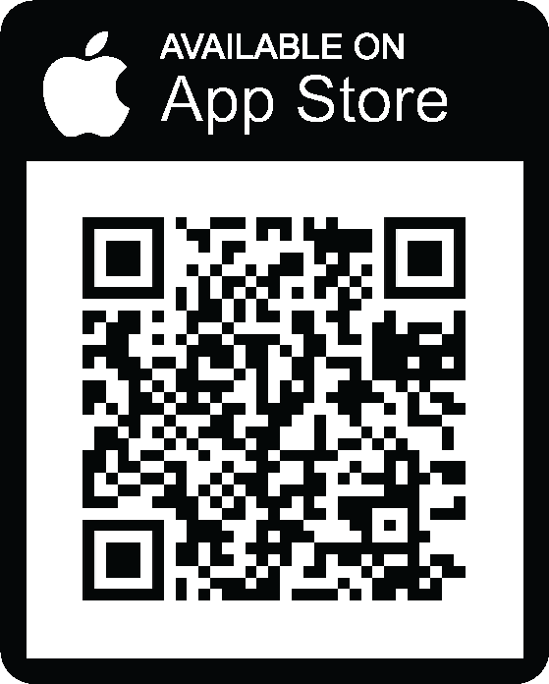
We’re Streaming on uStudio!
Empower Your Growth
Stay informed and up-to-date by streaming our latest company news, developments, policies, procedures, and best practices.
DOWNLOAD THE MOBILE APP TODAY!
Sign in using the company code COMPANYCODE.
Don’t think you received an invite email? Search your email inbox, spam and trash folders for “Streaming and Podcast App”. If you can’t find the invite contact your streaming network administrator for help.
For uStudio mobile application issues contact support@ustudio.com.

Slide 2
Now Streaming on uStudio!
Art of Selling with Jake Jakerson
Join Jake Jakerson for his indepth show Art of Selling, a great source for sales tips and tricks. Dive deep into the art and science of selling our groundbreaking products to prospects.
Download the
Mobile App Today!
Sign in using the company code: COMPANYCODE
Need access? Contact your streaming network admin.
For uStudio mobile application issues contact support@ustudio.com.

